Slide 1
Mitigating Bird Strikes in Aviation
Mentor: Munna Pandey
submitted by: S. Pratheek
Wave number:4777
Batch Number:da374S37

Slide 2
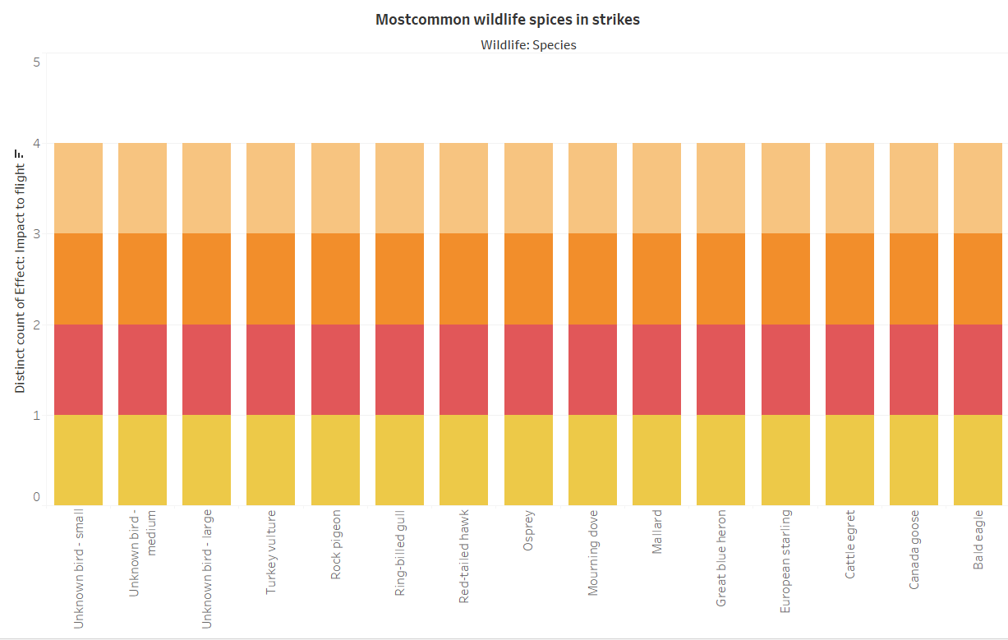
Safety Improvement
Interpretation:The Turkeyvulture,Rock piegon,Ring-biledgull,Red_tailedhawk etc are birds which involve in alot strike because this birds are involved in strike and each impact to filght and high to number of effects in impact on flight in abrotted takeoff,engine failure,precautionary landings,others.

Slide 3
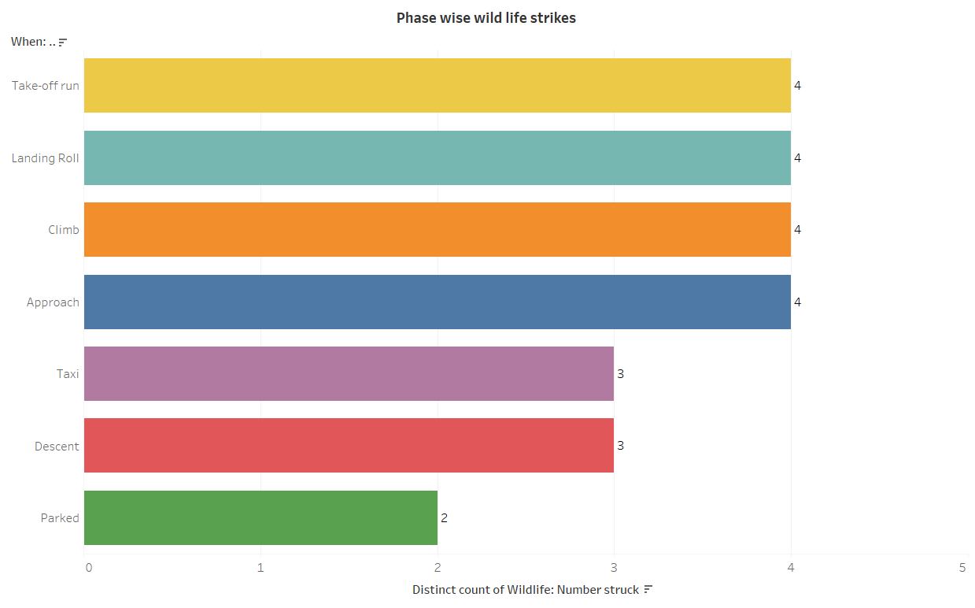
.
Interpretation: In Takeoff,Landing Roll,Climb,Approach phase wildlife strike mostly

Slide 4
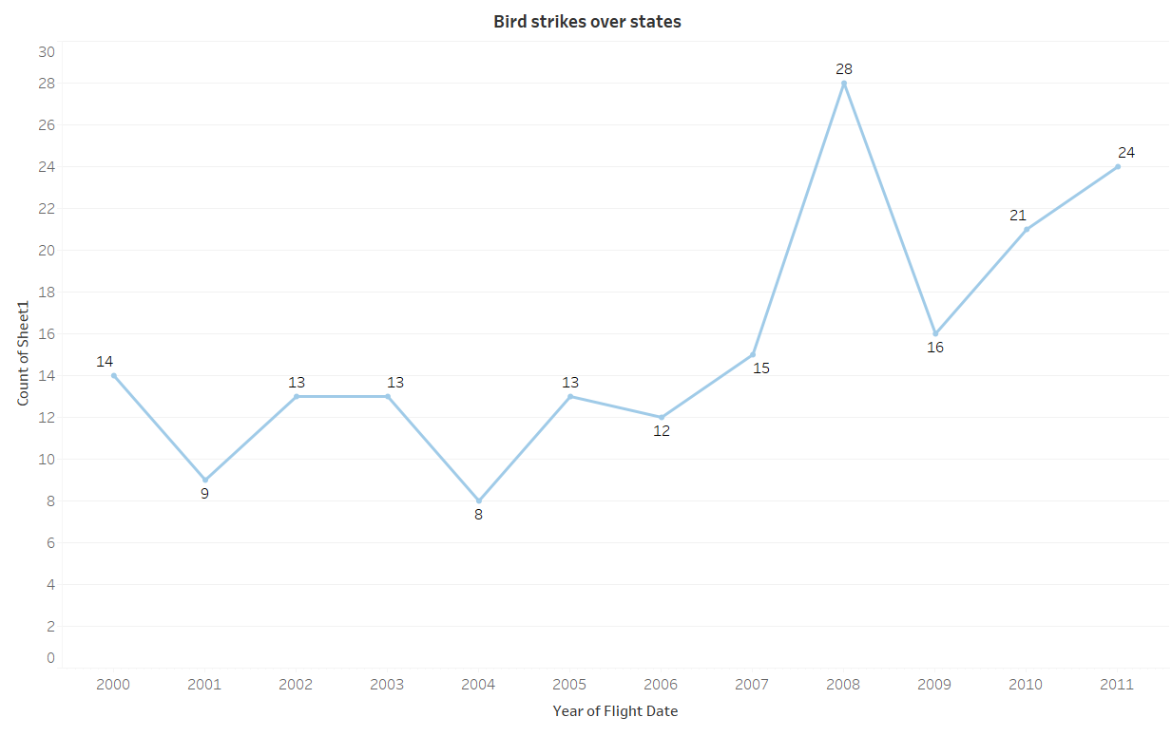
.
Interpretation: Bird strikes over states in different years by using state filter we can find trend for each state in alaska in 2008 has high number of strikes

Slide 5
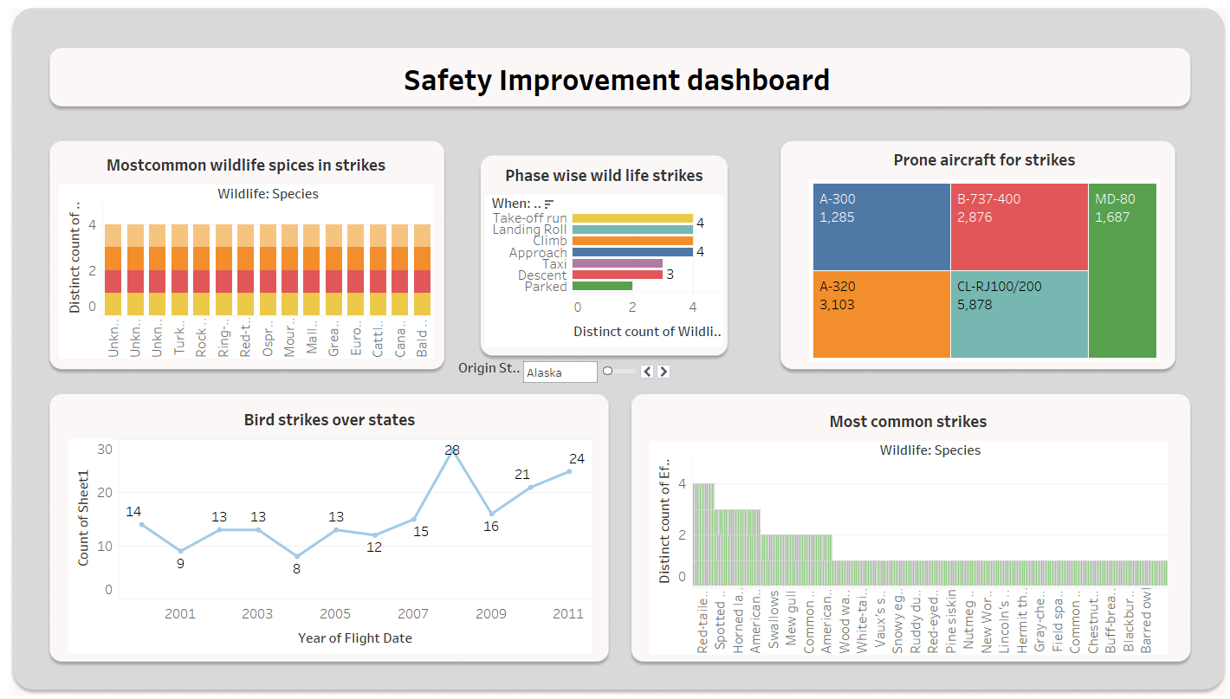
.
Interpretation: The safety improvement dashboard visualize the common widelife species in strikes and aricrafts involved in strikes and trend of brids strike over states form this dashboard i can identified the issuses and overcome them to improve the safety

Slide 6
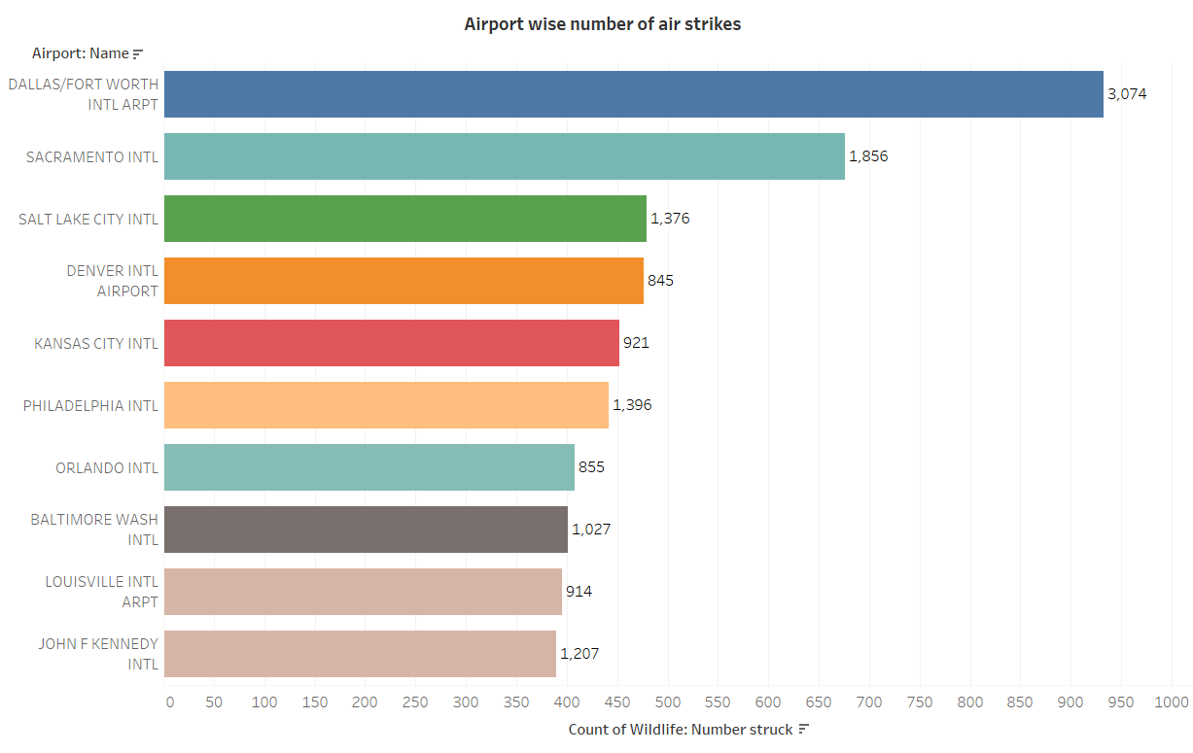
Regulatory Compliance
Interpretation: Dallas/Fort worth intl airpot has high number of air strikes among all airports by filtering airport name by counting number of strikes

Slide 7
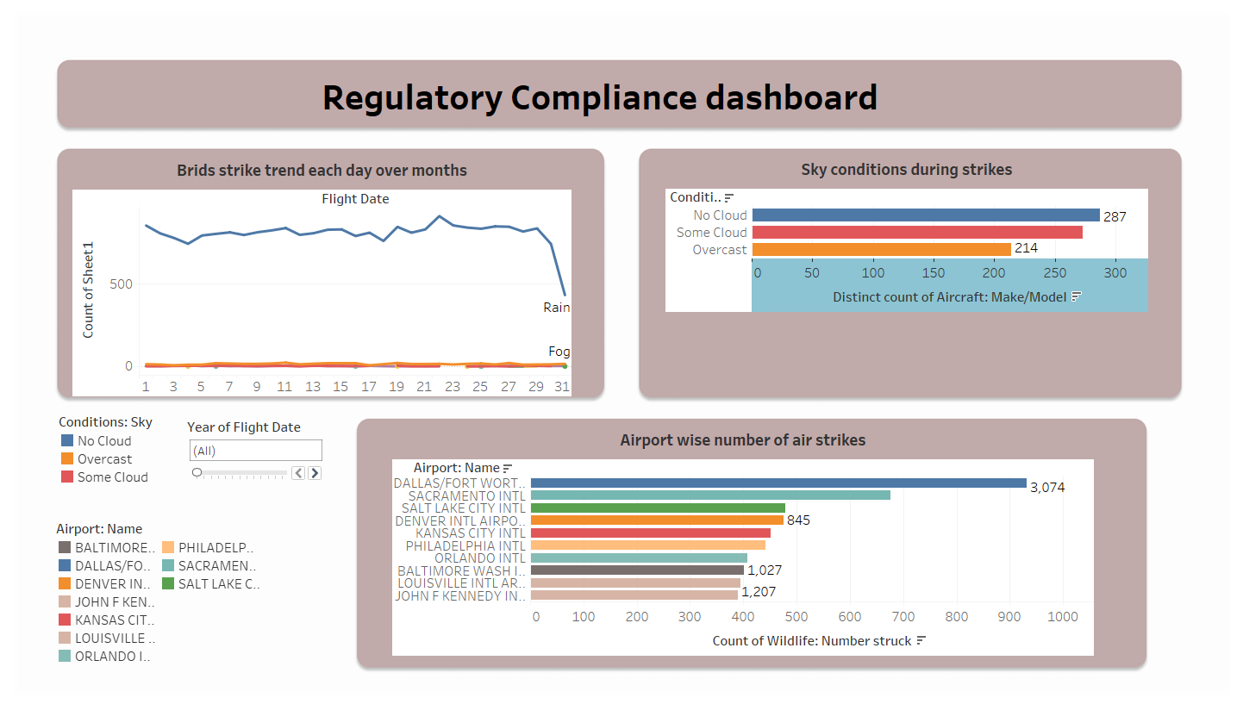
.
Interpretation: The regulartory compliance dashboard visualizes the brid strike over months ,sky conditions and sair with high number of air strikes .In this dashboard the airports ,sky conditons visualizations are used has filters to know the brid strike trend at different air ports under different sky conditions.

Slide 8
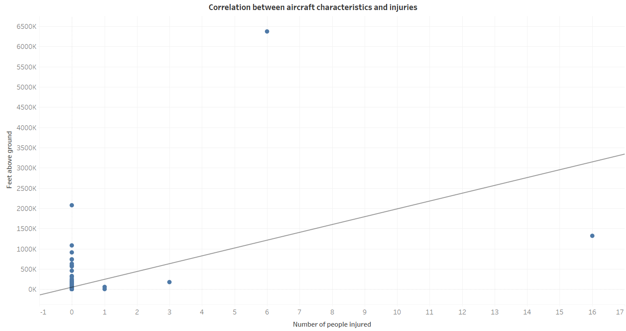
Injury Prevention
Interpretation: The correlation between aircraft characteristics and number of injured is a positive correlation according to scatterplot trendline

Slide 9
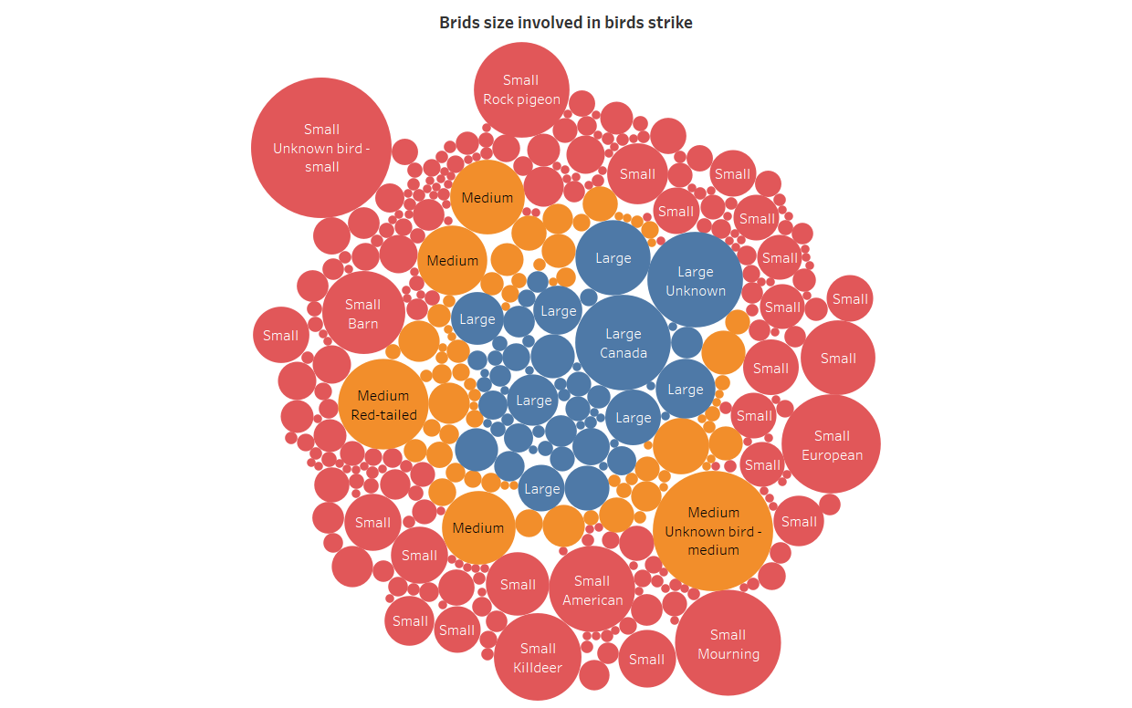
Wildlife Conservation
Interpretation: The small size birds has high strikes it involves small rock piegon,small unkown bird,then medium size birds and last large size birds.

Slide 10
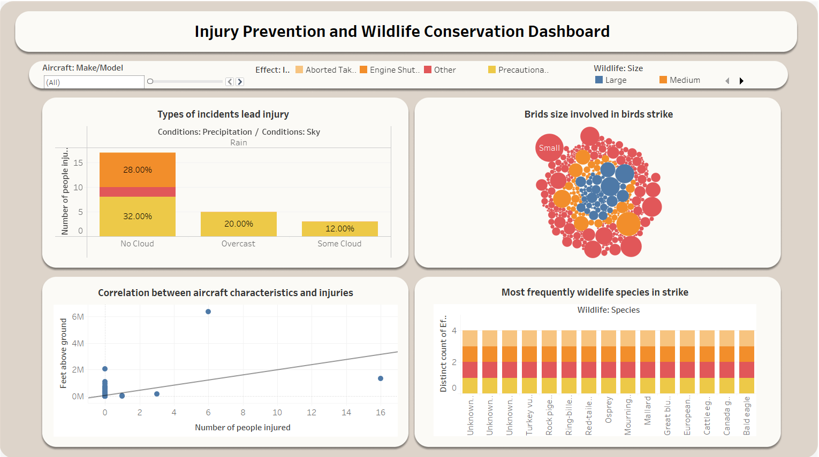
.
Interpretation: The injury prevention and wildlife conservation dashboard visulizes types of incidents lead injury,birds involved in strike,correlation betwen aircraft characteristics and injuries,commom wildlife in strike the commom widlife is used has filteer so we can visualize each wilde life strikes and incidents lead to injury and it to slove it and aircraft model is also used as filter fior the dashboard

Slide 11
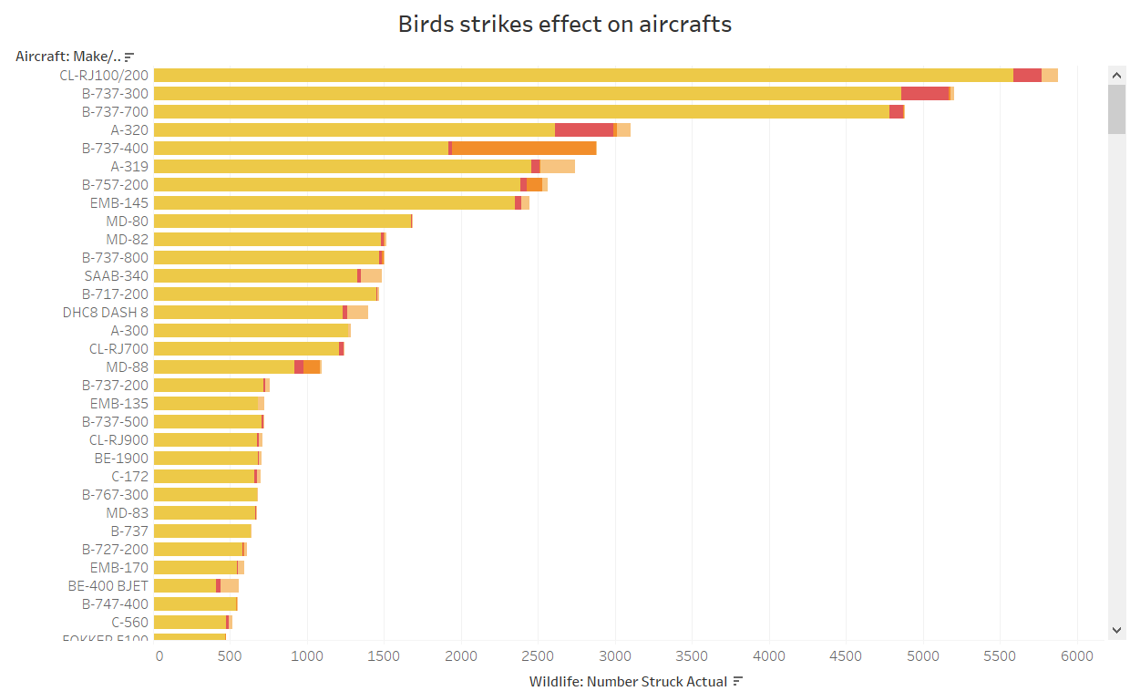
Operational Efficiency
Interpretation: The bird strike effect the and damage which cause aserious trouble majority of it unexcpeted landing of filght ,engine failure which cause injury the people in flight.

Slide 12
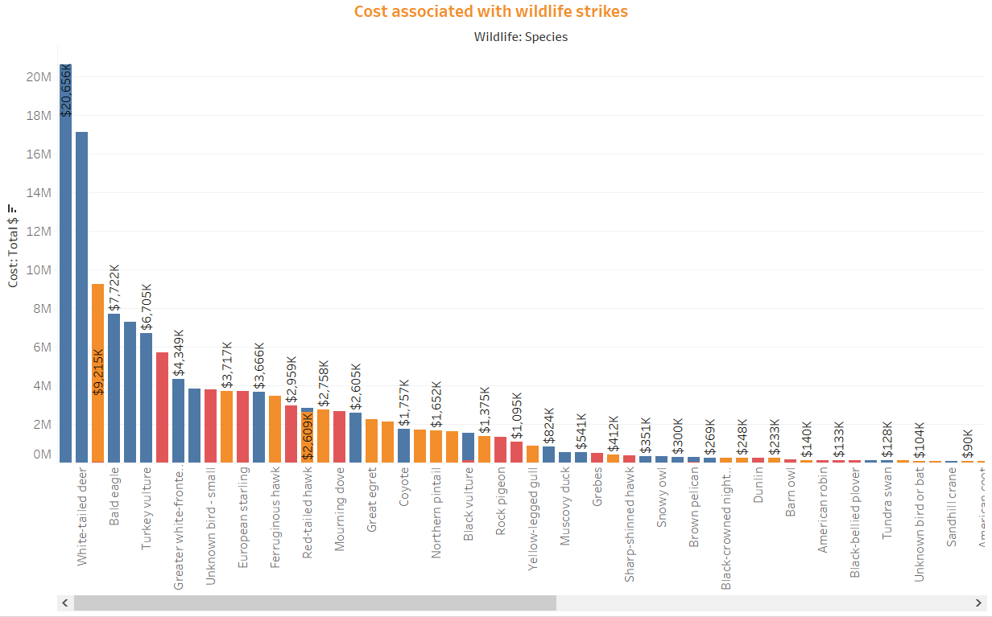
Cost Reduction
Interpretation: The Canada goose has highest cost including damage $20,656k and least cost is $1k for many wildlife species

Slide 13
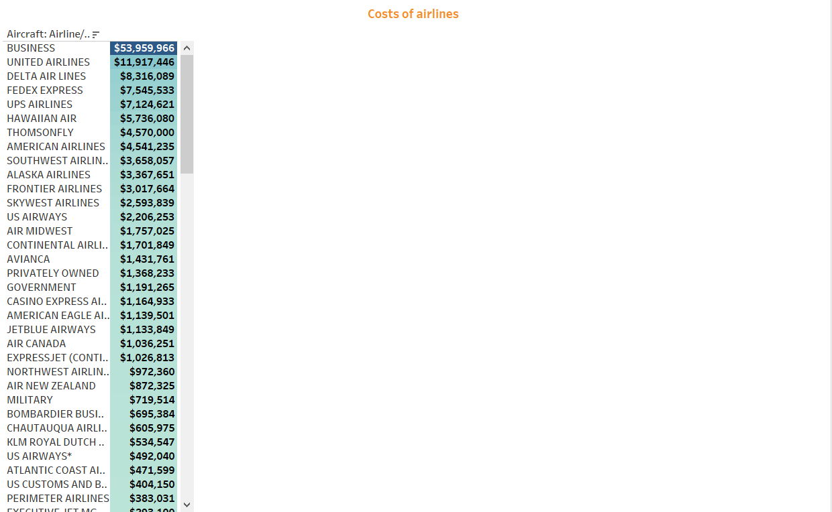
.
Interpretation: The bussiness airline faced high cost due to bird strikes also united airlines,delta airlines etc have faced high cost, cape air,business aviation etc faced low cost due to bird strikes

Slide 14
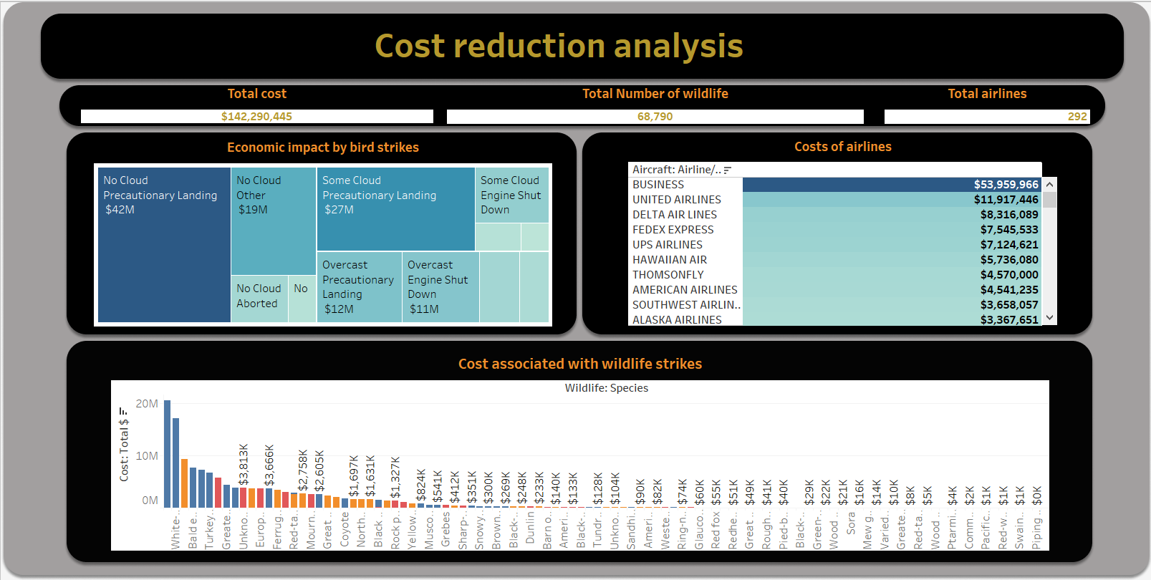
.
Interpretation: The cost reduction analysis visualizes the costs of different airlines by bird strikes and each wildlife cost and economic impact caused by the strikes to over come them the pilot training should be change and time of flight should be more correctly calculated sky conditions,filght sike ,number of engines and its speed so that it reduces the bird strikes and which in handedly reduce cost of airline to spend on it.

Slide 15
Summary and business conclusion
The Turkeyvulture,Rock piegon,Ring-biledgull,Red_tailedhawk etc are birds involve in alot strike ,Takeoff,Landing Roll,Climb,Approach phase wildlife strike mostly.
Bird strikes over states in different years by using state filter trend in alaska 2008 has high number of strikes.
Dallas/Fort worth inl airport has high number of air strikes among all airports.
The correlation between aircraft characteristics and number of injured is a positive correlation between the two factors.
The small size birds has high strikes like small rock pigeon etc ,then medium size birds and last large size birds involve in bird strikes
The bird strike effect damage which cause majority troubleof it un excpeted landing of flight ,engine failure which cause injury the people in flight.
Conclusion:
From above analysis of Mitigating Bird Strikes in Aviation data exploration ,major causes of bird strike are due to wrong time flights departure un conditioned weathers
Mainly in rainy conditions the birds strikes are more small birds are more numbers in bird strikes which also leadr air lines to spent more amount on bird strikes on there airlines
To overcome this and minimize the cost the airlines should more effective analyze the weather conditions of the loactions and set flight departures accordingly , the condition for large and small flights should be vary the large sixe aircraft should have charetertics more accurately also depend on number of engines.
The aircraft should fly in the location where wildlife species doesn’t fly more .By overcoming above things the wildlife strikes can be decreased and cost of airlines on the strikes decreased .

